Slide 1
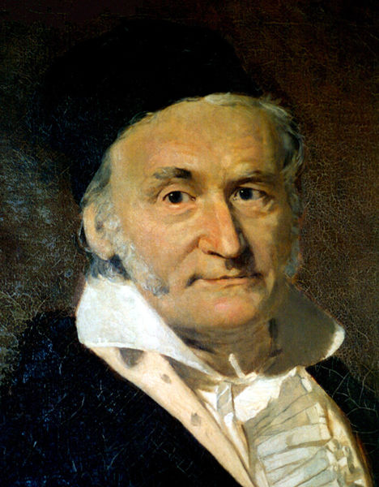
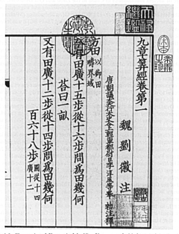
Solving Sets of Equations
150 B.C.E., 九章算術
Carl Friedrich Gauss, 1777-1855

Slide 2
Ill-Conditioned Systems
“A system is ill-conditioned if the solution is very sensitive to changes in the input”
Example: a near-singular coefficient matrix
We cannot test the accuracy of a computed solution merely
by substituting the solution into the equation to see whether the right-hand sides are reproduced

Slide 3
Condition Numbers and Norms
The condition number of a matrix is defined in terms of norms
We’ll define the condition number of a matrix after introducing the vector and matrix norms

Slide 4
Vector Norms
Magnitude, modulus, or absolute value for scalars generalizes to norms for vectors
We will use only p-norm, defined by for integer p > 0 and n-vector x
Important special cases
1-norm
2-norm
∞-norm

Slide 5
Properties of Vector Norms
For any definition of a vector norm, it needs to satisfy the following properties

Slide 6
Matrix Norms
Matrix norm corresponding to a given vector norm is defined by
A matrix norm measures the maximal stretch that a matrix does to any vector in a given vector norm

Slide 7
Matrix Norms
Matrix norm corresponding to vector 1-nom is maximal absolute column sum
Matrix norm corresponding to vector ∞-norm is maximum absolute row sum
Handy way to remember these is that matrix norms agree with corresponding vector norms for n by 1 matrix
Notes:
A memorable way: let matrix A be an n by 1 matrix

Slide 8
Proof of matrix’s 1-norm
Triangle inequality
We can pick a vector x such that xk is the only nonzero element if || ak || is the largest one among all column vectors of A

Slide 9
Properties of Matrix Norms
Matrix norms we have defined satisfies
Above are actually the required properties when a matrix norm is defined!

Slide 10
Condition Number
Condition number of a nonsingular matrix A is defined by
By convention, cond(A) = ∞ if A is singular
Large cond(A) means A is singular
Since condition number measures the ratio of maximal stretch to maximal shrink that a matrix does to any nonzero vectors

Slide 11
Properties of Condition Number
For any matrix A, cond(A) ≥ 1
For identity matrix, cond(I) = 1
For any matrix A and scalar k, cond(kA) = cond(A)

Slide 12
Computing Condition Number
Definition of the condition number involves matrix inverse, so it is nontrivial to compute
Computing condition number from definition would require much more work than computing solution whose accuracy is to be assessed
In practice, condition number is estimated inexpensively as byproduct of solution process

Slide 13
Error Bounds
Condition number yields the error bound for a computed solution to a linear system
Let x be the solution to Ax = b, and be an approximate solution, r is residual

Slide 14
Error Bounds (cont.)
Similarly, from b = Ax and x = A⁻¹b we obtain
Combined with previous result
We have

Slide 15
Error Bounds (cont.)
Similarly, from b = Ax and x = A⁻¹b we obtain
Combined with previous result
We have
condition number of A!

Slide 16
Error Bounds (cont.)
The relative error in the computed solution vector is bounded by the relative residual divided/multiplied by the condition number
When the condition number is large, the residual gives little information about the accuracy

Slide 17
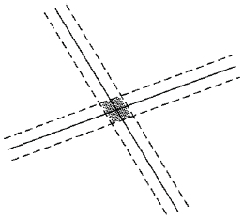
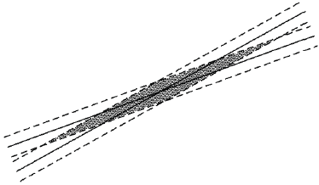
Error Bounds – Illustration
In two dimensions, uncertainty in the intersection point of two lines depends on whether lines are nearly parallel
well-conditioned
ill-conditioned

Slide 18
Residual
Residual vector of an approximate solution to the linear system Ax = b is defined by
In theory, if A is nonsingular, then if, and only if, but they are not necessarily small simultaneously
Since small relative residual implies small relative error in approximate solution only if A is well-conditioned

Slide 19
Iterative Refinement
Given an approximate solution x₀ to a linear system Ax = b, compute residual
Now solve the linear system Az₀ = r₀ and take as new and “better” approximate solution, since

Slide 20
Iterative Refinement (cont.)
Process can be repeated to refine the solution successively until convergence, potentially producing solution accurate to full machine precision

Slide 21
Error in Coefficients of Matrix
Let be the perturbed coefficient matrix and the solution to the perturbed system
Using and

Slide 22
Error in Coefficients of Matrix (cont.)
Relative error of the computed solution can be as large as the relative error in the coefficients of A multiplied by the condition number

Slide 23
Computing Condition Number
Matrix norm is easily computed as maximal column sum (or row sum, depending on norm used)
Estimating at low cost is more challenging
From properties of norms, if Az = y, then and bound is achieved for optimally chosen y

Slide 24
Computing Condition Number
Efficient condition estimators heuristically pick y with large ratio , yielding good estimator for
Good software packages for linear systems provide efficient and reliable condition estimator

